Slide 1
Name: Dharineesh Karthikeyan Roll.no: CB.SC.I5DAS18006 Title: AutoML App for Learning/Deploying Machine Learning models

Slide 2
Tentative Problem - Recap
AutoML stands for Automated Machine Learning which provides methods and processes to make Machine Learning available for non-Machine Learning experts, to improve efficiency of Machine Learning and to accelerate research on Machine Learning.
By automating the time-consuming, iterative tasks of machine learning model development. It allows data scientists, analysts, and developers to build ML models with high scale, efficiency, and productivity all while sustaining model quality.
The success of a machine learning (ML) model crucially relies on human machine learning experts to perform the following tasks:
• Pre-process and clean the data.
• Select and construct appropriate features.
• Select an appropriate model.
• Optimize model hyperparameters.
• Critically analyze the results obtained.
When trying to build an AutoML system we need to take into considerations all of the above tasks and make sure they can be automated and made easy for a non-Machine learning expert to understand and build machine learning models on any data needed.

Slide 3
Last Review
In the last review, I had successfully completed the classification task of the AutoML.
I also created a simple web-based UI using Streamlit to support the task of automatically creating ML models by the user using just buttons and not writing a single line of code for any dataset.
During the last review, there were a few bugs/issues with the automating part of a few sections of the classification task which had to be fixed.
In the last review, the future plans for the project plan included introducing a more user-friendly front end app for user to interact with, and also complete the regression task of AutoML as well.

Slide 4
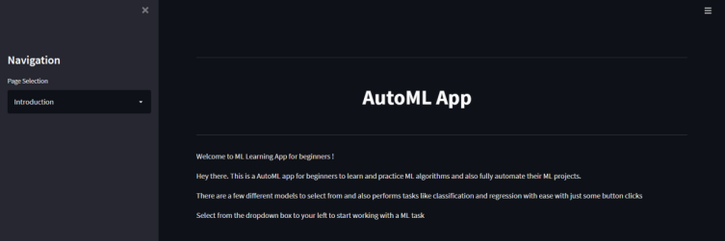
User-friendly UI (Introduction Page)
Whenever the user loads the app, he is first greeted with a simple welcome page and directs the user to the next upcoming pages depending on the user’s needs.
The user depending on his needs/choice can choose if he wants to perform a classification or regression task.

Slide 5
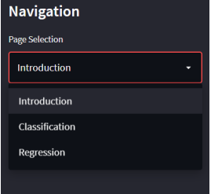
On the left side of the introduction page, the user can select the intended task – classification or regression with the help of the dropdown box provided.
Based on the user’s selection, the corresponding page is loaded and the user can start building the model by uploading the dataset first.

Slide 6
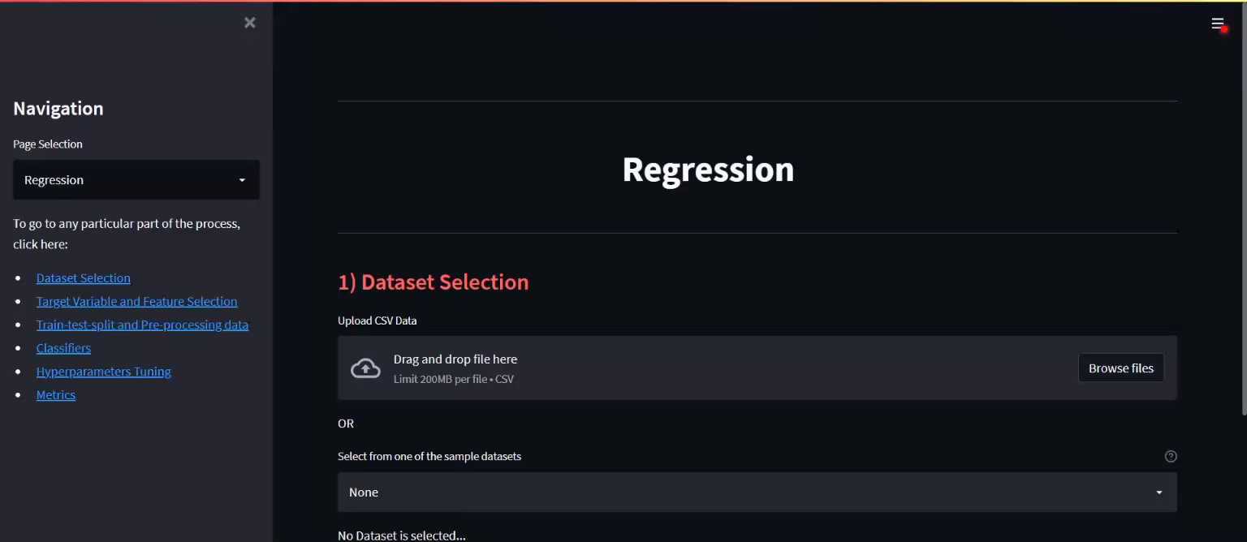
AutoML - Regression Task

Slide 7
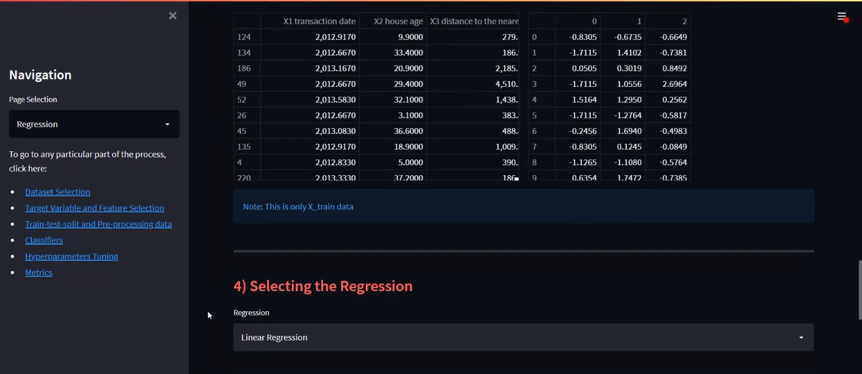

Slide 8
Conclusion
I have built a AutoML app that is fully automated and any user can build a classification/regression model in under 2-3 mins without using even a single line of code.
The AutoML app potentially includes every stage from beginning with a raw dataset to building a machine learning model ready for deployment. It also has the ability to help with learning of machine learning model for beginners and also able to deploy small real world and industrial projects.
The added benefit of being a web-based application, means that it can be easily deployed and accessed by anyone.

Slide 9
Scope for improvements
The AutoML application was built with scalability in mind for future updates with ease. The classification/regression models available at the moment can be increased in the future by adding support to more models and also more pre-processing steps and hyperparameters.
Also, if the project could be integrated with a cloud service subscription. It would help increase the app’s ability to build more higher scale projects which require more storage facilities and computational power.

Slide 10
Thank You

